Slide 1
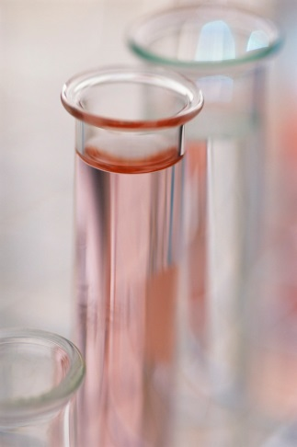
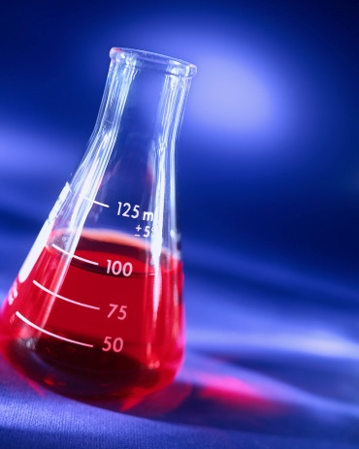
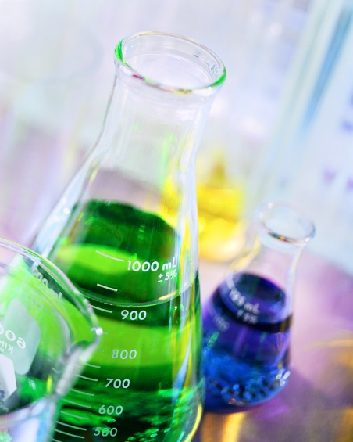
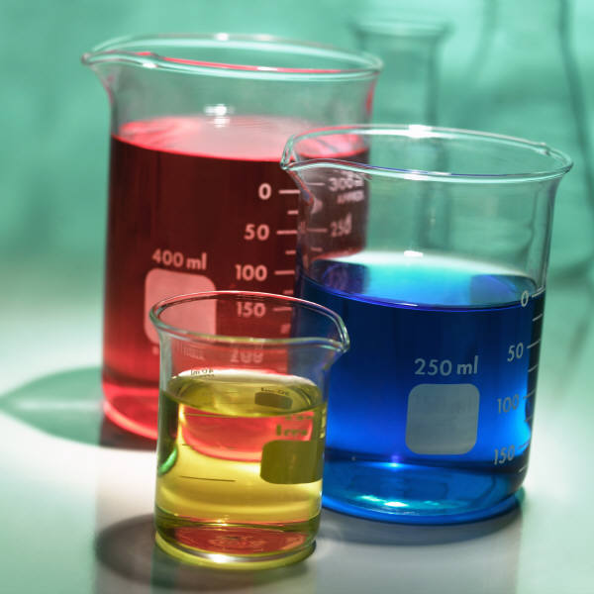
Rates of Chemical Reactions

Slide 2
Reaction Rate
Kinetics is the study of reaction rates.
Reaction Rate – Rate at which reactants change into products over time.
Reaction rates tell you how fast a reaction is going. In other words,
how fast the reactants are being consumed
how fast the products are being formed
How fast energy is being absorbed or released

Slide 3
Rates of Chemical Reactions
The Collision Theory relates particle collisions to reaction rate. Rate depends on how often particles collide with one another.
The greater the number of collisions, the higher the reaction rate or the less number of collisions, the lower the reaction rate.
The rate of reaction is affected by Five factors: concentration, surface area, temperature, catalysts, and stirring

Slide 4
Concentration
Slower Rate
Faster Rate
Concentration is the measure of the amount of substance in a given unit of volume.
The more reacting particles that are present in a given volume, the more opportunities there are for collisions and distance between reactant particles decreases so they collide more often.

Slide 5
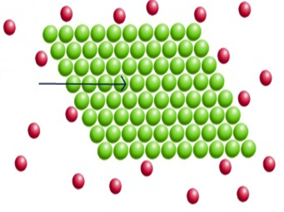
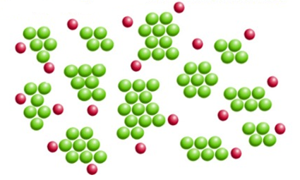
Surface Area
Same # of Atoms/Mass
Slower Rate
Faster Rate
Increase in surface area increases the exposure of the particles of the reactants to one another. The greater this exposure, the more collisions there are that involve reacting particles. More collisions causes the rate to increase.

Slide 6
Temperature
Slower Rate
Faster Rate
Increasing the temperature of a substance causes the particles to move faster. Particles that move faster are more likely to collide and react. More collisions causes the rate to increase.

Slide 7
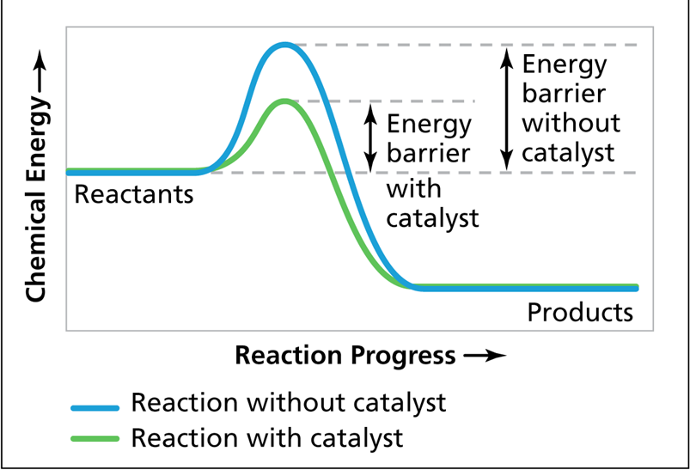
Catalysts
Catalyst is a substance that usually increases the rate of reaction but is not itself changed by the reaction.
Increases the rate by lowering the activation energy needed to break the bonds to start a chemical reaction.

Slide 8
Stirring
Increases the exposure of the reactants to each other. This causes the collisions between the particles of the reactants to happen more often causing an increase in the reaction rate.

